Slide 1

MX2020 Big Data
Data Leke Reference Architecture
Deequ
Junio 02, 2020

Slide 2
Change control
Versión | Fecha | Descripción del Cambio | Autor/Departamento
0.1 | 01/06/2020 | Creation of the document | [Big Data Architecture] Susana Edith Barrientos Galicia
0.2 | 03/06/2020 | CommonLog internal structure diagrams are integrated | Big Data Architecture] Susana Edith Barrientos Galicia
0.3 | 06/06/2020 | HBase model is integrated | Big Data Architecture] Susana Edith Barrientos Galicia
0.4 | 09/06/2020 | The Hive model is integrated | Big Data Architecture] Susana Edith Barrientos Galicia
0.5 | 14/06/2020 | The general diagram of the Deequ component is integrated | Big Data Architecture] Susana Edith Barrientos Galicia
0.6 | 15/06/2020 | The general diagram of the Deequ component modules is integrated | Big Data Architecture] Susana Edith Barrientos Galicia

Slide 3
Change control
Versión | Fecha | Descripción del Cambio | Autor/Departamento
0.7 | 15/06/2020 | The Constraints available for composing user data quality checks table is integrated | Big Data Architecture] Susana Edith Barrientos Galicia
0.8 | 15/06/2020 | The Computable metrics to base constraints on table is integrated | Big Data Architecture] Susana Edith Barrientos Galicia
0.9 | 18/06/2020 | The general diagram of the Deequ component modules is integrated | Big Data Architecture] Susana Edith Barrientos Galicia
0.10 | 19/06/2020 | The Hive model is integrated | Big Data Architecture] Susana Edith Barrientos Galicia
0.11 | 20/06/2020 | The first version of the analyzer module class diagram is integrated | Big Data Architecture] Susana Edith Barrientos Galicia

Slide 4
Table of Contents
Features and terminology
Needs and Solution Proposal
Graphic Representation of the Solution
Infrastructure and Connectivity
General services
Risks and Dependencies
Standards, Patterns and Decisions of Architecture
References and Annexes

Slide 5
Features and terminology

Slide 6



Features and terminology (I)
Data Lake - Deequ
Data Sources
Acquisition & Ingest layer
Processing Layer
Engine-Ingest
Raw
Curated
Augmented
Layers of Architecture of a Data Lake
Batch Layer
N... node
Functional division for the data life cycle
Hue
Hue
Sentry, Kerberos
UI Framework
SDK
Workflow
Workflow
Hive
Oozie
Scheduler
Metadata
Languages, Compilers
Fast read / write access
Flume, Sqoop
Pig / Hive
HBase
Data Integration
Components of the batch layer
HDFS
Hadoop Distributed File Systems
Job
Spark
Processing
YARN
Resources Manager
Zookeeper
Coordination
cloudera
Data Lake

Slide 7
Needs and Solution Proposal (I)
Descripción de la solución técnica I
Objective
Define the Dquee component architecture, in order to at least meet the following non-functional requirements:
Reusability
Maintainability
Scalability
Ease of Testing
Performance
Scope
Graphically represent all architectural views for the Dquee component
Description
Apply the following data quality dimensions to the Data Lake
ApproxQuantile: Approximate quantile of a distribution.
ApproxQuantiles: Approximate quantiles of a distribution.
Completeness: Fraction of non-null values in a column.
Compliance: Fraction of rows that comply with the given column constraint.
Correlation: Pearson correlation coefficient, measures the linear correlation between two columns.
CountDistinct: Number of distinct values.
DataType: Distribution of data types such as Boolean, Fractional, Integral, and String.

Slide 8
Needs and Solution Proposal (I)
Descripción de la solución técnica II
Description II
Apply the following data quality dimensions to the Data Lake
Distinctness: Fraction of distinct values of a column over the number of all values of a column.
Entropy: Entropy is a measure of the level of information contained in an event (value in a column) when considering all possible events (values in a column). It is measured in nats (natural units of information).
Maximum: Maximum value.
Minimum: Minimum value.
MutualInformation: Mutual information describes how much information about one column (one random variable) can be inferred from another column (another random variable).
Size: Number of rows
Sum: Sum of all values of a column.
UniqueValueRatio: Fraction of unique values over the number of all distinct values of a column. Unique values occur exactly once; distinct values occur at least once.
Uniqueness: Fraction of unique values over the number of all values of a column.

Slide 9
Needs and Solution Proposal (I)
Descripción de la solución técnica III
Description II
The general idea behind the Deequ component is to allow at runtime to easily define tests to data sets in a declarative way. These tests consist of restrictions on the data that can be combined with functions defined by the Data Governance area.
Constraint | Arguments | Semantic
dimension completeness
isComplete | column | check that there are no missing values in a column
hasCompleteness | column, udf | custom validation of the fraction of missing values in a column
dimension consistency
isUnique | column | check that there are no duplicates in a column
hasUniqueness | column, udf | custom validation of the unique value ratio in a column
hasDistinctness | column, udf | custom validation of the unique row ratio in a column
isInRange | column, value range | validation of the fraction of values that are in a valid range
hasConsistentType | column | validation of the largest fraction of values that have the same type
isNonNegative | column | validation whether all values in a numeric column are non-negative
isLessThan | column pair | validation whether values in the 1s column are always less than in the 2nd column
satisfies | predicate | validation whether all rows match predicate
satisfiesIf | predicate pair | validation whether all rows matching 1st predicate also match 2nd predicate
hasPredictability | column, column(s), udf | user-defined validation of the predictability of a column
statistics (can be used to verify dimensionconsistency)
hasSize | udf | custom validation of the number of records
hasTypeConsistency | column, udf | custom validation of the maximum fraction of values of the same data type
hasCountDistinct | column | custom validation of the number of distinct non-null values in a column
hasApproxCountDistinctc | column, udf | custom validation of the approx. number of distinct non-null values
hasMin | column, udf | custom validation of a column’s minimum value
hasMax | column, udf | custom validation of a column’s maximum value
hasMean | column, udf | custom validation of a column’s mean value
hasStandardDeviation | column, udf | custom validation of a column’s standard deviation
hasApproxQuantile | column, quantile, udf | custom validation of a particular quantile of a column (approx.)
hasEntropy | column, udf | custom validation of a column’s entropy
hasMutualInformation | column pair, udf | custom validation of a column pair’s mutual information
hasHistogramValues | column, udf | custom validation of column histogram
hasCorrelation | column pair, udf | custom validation of a column pair’s correlation
time
hasNoAnomalies | metric, detector | validation of anomalies in time series of metric values
Table 1. Restrictions available to compose data quality controls defined by the Data Governance area in each project.

Slide 10
Needs and Solution Proposal (I)
Descripción de la solución técnica IV
Metric | Semantic
dimension completeness
Completeness | fraction of non-missing values in a column
dimension consistency
Size | number of records
Compliance | ratio of columns matching predicate
Uniqueness | unique value ratio in a column
Distinctness | unique row ratio in a column
ValueRange | value range verification for a column
DataType | data type inference for a column
Predictability | predictability of values in a column
statistics (can be used to verify dimensionconsistency)
Minimum | minimal value in a column
Maximum | maximal value in a column
Mean | mean value in a column
StandardDeviation | standard deviation of thevalue distribution in a column
CountDistinct ApproxCountDistinct | value range verification for a column
ApproxQuantile | number of distinct values in a column
Correlation | estimated by a hyperloglog sketch approximate quantile of the valuein a column
Entropy | entropy of the value distribution in a column
Histogram | histogram of an optionally binned column
MutualInformation | mutual information between two columns
Table 2. Computable metrics to base constraints on.

Slide 11

Needs and Solution Proposal (II)
New component
Component to modify
Data Lake - Deequ – Global Architecture I
Component not contemplated
General flow
Data Sources
Serving Layer
Integration with Hadoop components
Acquisition & Ingest layer
Processing Layer
A
B
Raw
Curated
Augmented
Visualization Tool
Pendientec
3.
Batch Layer
N... node
Hue
Hue
Sentry, Kerberos
UI Framework
SDK
Workflow
Workflow
Hive
Oozie
Scheduler
Metadata
Languages, Compilers
Fast read / write access
Flume, Sqoop
Pig / Hive
HBase
Data Integration
A
1.
HDFS
Hadoop Distributed File Systems
B
Job
Spark
Processing
2.
YARN
Resources Manager
Zookeeper
Coordination
cloudera

Slide 12
Needs and Solution Proposal (III)
New component
Component to modify
Data Lake - Deequ – Global Architecture II
Module not considered in a first phase
General flow
Client Component
Client Component:
Data:
Metric calculation: Deequ calculates data quality metrics, that is, statistics such as integrity, maximum or correlation. Deequ uses Spark to read sources (HDFS, Hive, Impala, etc.) and to calculate metrics through an optimized set of aggregation queries. You have direct access to the raw metrics calculated in the data.
Constraint verification: The component is intended to allow choosing data quality constraints according to projects (the component is prepared to use automated constraint suggestion methods that profile the data to infer useful constraints.
Constraint Suggestion: Allows you to choose data quality constraints according to projects (component is prepared to use automated constraint hint methods that profile data to infer useful constraints)
1.
Deequ
3a.
Intermediate States
Data Quality Constraints
6.
3b.
Metrics History
5.
4.
Constraint Suggestion
Constraint
Verification
Data
Metrics
8.
Metrics Report
7.
Apache Spark
Metric calculation
3.
2.

Slide 13
Needs and Solution Proposal (IV)
Data Lake - Deequ – Global Architecture III
select the declarative constraint definition Runtime
Client Component
Checks and Constraints API
Declarative Constraint Definition Runtime
Metrics
Analyzers
Calculate RUnetimec
Anomaly Detectors
Batch
Computation
(Spark)
Incremental Computation
(Spark)
Metrics History
(Hbase - Hive)
Intermediate (Hbase - Hive)
Storage

Slide 14
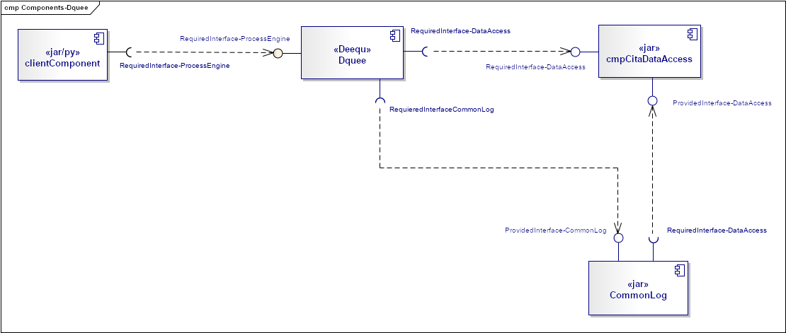
Needs and Solution Proposal (IV)
New component
Component to modify
Data Lake - Deequ – Global Architecture III
Module not considered in a first phase

Slide 15
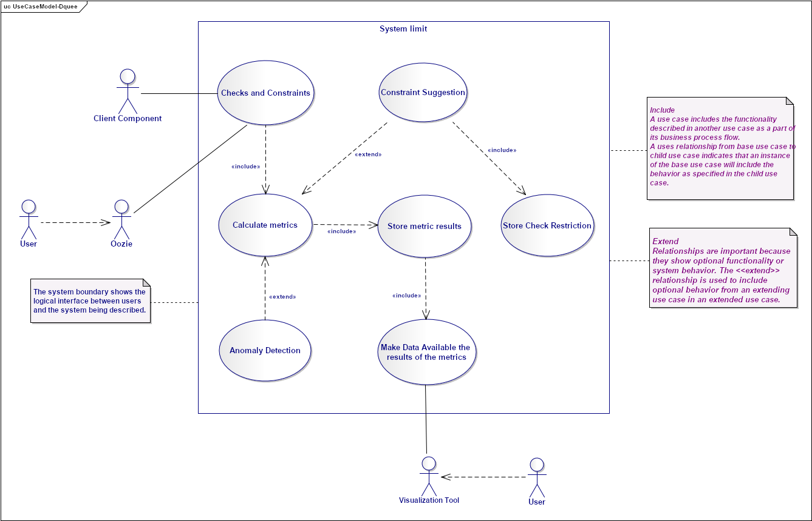
Needs and Solution Proposal (V)
Data Lake - Deequ – Use Case View II

Slide 16
Needs and Solution Proposal (VI)
Data Lake - Deequ – Model Metrics Report Hbase I
{
fdc-000000001 :
{
Source: {
System:{timestamp1: "FraudControl"}
Type:{timestamp1: "File"}
FileName:{timestamp1: "SomeName"}
FileHeaderDefinition:{timestamp1: "dsdepto,dsgotrab,dstitdem"}
DelimiterType:{timestamp1: "Pendiente"}
DataBaseName:{timestamp1: "SomeBaseName"}
TableName:{timestamp1: "SomeTableName"}
RawPath:{timestamp1: "SomePathGoldenCopy"}
GoldenCopy:{timestamp1: "SomePathRaw"}
CompressionFormat:{timestamp1: "Snappy"}
ColumKey:{timestamp1: "SomeColumnKey"}
SecondColumKey:{timestamp1: "SomeSecondColumnKey"}
Frecuency:{timestamp1: "Daily"}
RowCont:{timestamp1: "12896"}
ColumnCount:{timestamp1: "895"}
CheckSum:{timestamp1: "268435"}
DataTypeValidation:{timestamp1: "int,char,date,int,double"}
IngestionStatus:{timestamp1: "0"}
ProcessDate:{timestamp1: "2020-06-02 5:51:26 PM"}
idStep:{timestamp1: "log-000000001"}
}
Target: {
Type:{timestamp1: "Hbase-Hive"}
DataBaseName:{timestamp1: "FraudControl"}
TableName:{timestamp1: "SomeTableName"}
CuratedPath:{timestamp1: "SomeName"}
RowCont:{timestamp1: "12896"}
ColumnCount:{timestamp1: "895"}
CheckSum:{timestamp1: "268435"}
DataTypeValidation:{timestamp1: "dsdepto,dsgotrab,dstitdem"}
TargetStatus:{timestamp1: "SomePathRaw"}
ProcessDate:{timestamp1: "2020-06-02 6:05:26 PM"}
}
Metrics: {
ColumCountStatus:{timestamp1: "0"}
ColumValidationStatus:{timestamp1: "0"}
CheckSumStatus:{timestamp1: "0"}
DataTypeValidationStatus:{timestamp1: "0"}
FileCheckStatus:{timestamp1: "0"}
RowCountStatus:{timestamp1: "0"}
DifferentColumns:{timestamp1: "dsdepto,dsgotrab,dstitdem"}
TotalMismatchCheckSum:{timestamp1: "1"}
TotalMismachRaws:{timestamp1: "2"}
TotalMismachColumns:{timestamp1: "2"}
DescriptionStatus: {timestamp1: "SomeDescription"}
}
}
}c
Logical Model
 | ReportMetrics
RowKey | Column_Family (Source)
Source + Random UUID | Column Source: System
 | Column Source: Type
 | Column Source: FileName
 | Column Source: FileHeaderDefinition
 | Column Source: DataBaseName
 | Column Source: TableName
 | Column Source: RawPath
 | Column Source: GoldenCopy
 | Column Source: CompressionFormat
 | Column Source: ColumKey
 | Column Source: SecondColumKey
 | Column Source: Frecuency
 | Column Source: RowCont
 | Column Source: ColumnCount
 | Column Source: CheckSum
 | Column Source: DataTypeValidation
 | Column Source: IngestionStatus
 | Column Source: ProcessDate
 | Column Source: idStep
 | Source
RowKey | System | Type | FileName | FileHeaderDefinition | DataBaseName | TableName | GoldenCopy | RawPath | CompressionFormat | ColumnKey | SecondColumnKey | Frecuency | RowCont | ColumnCount | CheckSum | DataTypeValidation | IngestionStatus | ProcessDate | idStep
fdc-000000001 | FraudControl | File | SomeName | dsdepto,dsgotrab,dstitdem | SomeBaseName | SomeTableName | SomePathGoldenCopy | SomePathRaw | Snappy | SomeColumnKey | SomeSecondColumnKey | Daily | 12896 | 895 | 268435 | 0 | 0 | 6/2/20 17:51 | log-00000001

Slide 17
Needs and Solution Proposal (VII)
Data Lake - Deequ – Data Model Metrics Report Hbase II
{
fdc-000000001 :
{
Source: {
System:{timestamp1: "FraudControl"}
Type:{timestamp1: "File"}
FileName:{timestamp1: "SomeName"}
FileHeaderDefinition:{timestamp1: "dsdepto,dsgotrab,dstitdem"}
DelimiterType:{timestamp1: "Pendiente"}
DataBaseName:{timestamp1: "SomeBaseName"}
TableName:{timestamp1: "SomeTableName"}
RawPath:{timestamp1: "SomePathGoldenCopy"}
GoldenCopy:{timestamp1: "SomePathRaw"}
CompressionFormat:{timestamp1: "Snappy"}
ColumKey:{timestamp1: "SomeColumnKey"}
SecondColumKey:{timestamp1: "SomeSecondColumnKey"}
Frecuency:{timestamp1: "Daily"}
RowCont:{timestamp1: "12896"}
ColumnCount:{timestamp1: "895"}
CheckSum:{timestamp1: "268435"}
DataTypeValidation:{timestamp1: "int,char,date,int,double"}
IngestionStatus:{timestamp1: "0"}
ProcessDate:{timestamp1: "2020-06-02 5:51:26 PM"}
idStep:{timestamp1: "log-000000001"}
}
Target: {
Type:{timestamp1: "Hbase-Hive"}
DataBaseName:{timestamp1: "FraudControl"}
TableName:{timestamp1: "SomeTableName"}
CuratedPath:{timestamp1: "SomeName"}
RowCont:{timestamp1: "12896"}
ColumnCount:{timestamp1: "895"}
CheckSum:{timestamp1: "268435"}
DataTypeValidation:{timestamp1: "dsdepto,dsgotrab,dstitdem"}
TargetStatus:{timestamp1: "SomePathRaw"}
ProcessDate:{timestamp1: "2020-06-02 6:05:26 PM"}
}
Metrics: {
ColumCountStatus:{timestamp1: "0"}
ColumValidationStatus:{timestamp1: "0"}
CheckSumStatus:{timestamp1: "0"}
DataTypeValidationStatus:{timestamp1: "0"}
FileCheckStatus:{timestamp1: "0"}
RowCountStatus:{timestamp1: "0"}
DifferentColumns:{timestamp1: "dsdepto,dsgotrab,dstitdem"}
TotalMismatchCheckSum:{timestamp1: "1"}
TotalMismachRaws:{timestamp1: "2"}
TotalMismachColumns:{timestamp1: "2"}
DescriptionStatus: {timestamp1: "SomeDescription"}
}
}
}
Logical Model
 | ReportMetrics
RowKey | Column_Family (Target)
Source + Random UUID | Column Target: Type
 | Column Target: DataBaseName
 | Column Target: TableName
 | Column Target: CuratedPath
 | Column Target: RowCont
 | Column Target: ColumnCount
 | Column Target: CheckSum
 | Column Target: DataTypeValidation
 | Column Target: TargetStatus
 | Column Target: ProcessDate
 | Target
RowKey | Type | DataBaseName | TableName | TargetPath | RowCont | ColumnCount | CheckSum | DataTypeValidation | TargetStatus | ProcessDate
fdc-000000001 | Hbase-Hive | FraudControl | SomeTableName | SomeTargetPath | 12896 | 895 | 268435 | dsdepto,dsgotrab,dstitdem | SomePathRaw | 6/2/20 18:05

Slide 18
Needs and Solution Proposal (VIII)
Data Lake - Deequ – Data Model Metrics Report Hbase III
{
fdc-000000001 :
{
Source: {
System:{timestamp1: "FraudControl"}
Type:{timestamp1: "File"}
FileName:{timestamp1: "SomeName"}
FileHeaderDefinition:{timestamp1: "dsdepto,dsgotrab,dstitdem"}
DelimiterType:{timestamp1: "Pendiente"}
DataBaseName:{timestamp1: "SomeBaseName"}
TableName:{timestamp1: "SomeTableName"}
RawPath:{timestamp1: "SomePathGoldenCopy"}
GoldenCopy:{timestamp1: "SomePathRaw"}
CompressionFormat:{timestamp1: "Snappy"}
ColumKey:{timestamp1: "SomeColumnKey"}
SecondColumKey:{timestamp1: "SomeSecondColumnKey"}
Frecuency:{timestamp1: "Daily"}
RowCont:{timestamp1: "12896"}
ColumnCount:{timestamp1: "895"}
CheckSum:{timestamp1: "268435"}
DataTypeValidation:{timestamp1: "int,char,date,int,double"}
IngestionStatus:{timestamp1: "0"}
ProcessDate:{timestamp1: "2020-06-02 5:51:26 PM"}
idStep:{timestamp1: "log-000000001"}
}
Target: {
Type:{timestamp1: "Hbase-Hive"}
DataBaseName:{timestamp1: "FraudControl"}
TableName:{timestamp1: "SomeTableName"}
CuratedPath:{timestamp1: "SomeName"}
RowCont:{timestamp1: "12896"}
ColumnCount:{timestamp1: "895"}
CheckSum:{timestamp1: "268435"}
DataTypeValidation:{timestamp1: "dsdepto,dsgotrab,dstitdem"}
TargetStatus:{timestamp1: "SomePathRaw"}
ProcessDate:{timestamp1: "2020-06-02 6:05:26 PM"}
}
Metrics: {
ColumCountStatus:{timestamp1: "0"}
ColumValidationStatus:{timestamp1: "0"}
CheckSumStatus:{timestamp1: "0"}
DataTypeValidationStatus:{timestamp1: "0"}
FileCheckStatus:{timestamp1: "0"}
RowCountStatus:{timestamp1: "0"}
DifferentColumns:{timestamp1: "dsdepto,dsgotrab,dstitdem"}
TotalMismatchCheckSum:{timestamp1: "1"}
TotalMismachRaws:{timestamp1: "2"}
TotalMismachColumns:{timestamp1: "2"}
DescriptionStatus: {timestamp1: "SomeDescription"}
}
}
}
Logical Model
 | MetricsReport
RowKey | Column_Family (Metrics)
Source + Random UUID | Column Metrics: ColumCountStatus
 | Column Metrics: ColumValidationStatus
 | Column Metrics: CheckSumStatus
 | Column Metrics: DataTypeValidationStatus
 | Column Metrics: FileCheckStatus
 | Column Metrics: RowCountStatus
 | Column Metrics: DifferentColumns
 | Column Metrics: TotalMismatchCheckSum
 | Column Metrics: TotalMismachRaws
 | Column Metrics: TotalMismachColumns
 | Column Metrics: DescriptionStatus
 | Metrics
RowKey | ColumCountStatus | ColumValidationStatus | CheckSumStatus | DataTypeValidationStatus | FileCheckStatus | RowCountStatus | DifferentColumns | TotalMismatchCheckSum | TotalMismachRaws | TotalMismachColumns
fdc-000000001 | 0 | 0 | 0 | 0 | 0 | 0 | 2 | 2 | 2 | 2

Slide 19
Needs and Solution Proposal (IX)
Data Lake - Deequ – Data Model Metrics Report Hive I
Table
Metrics Report
Partition…n
Partition 1
Partition 2
Bucket 1
ProcessDate
Bucket… n
ProcessDate
Bucket… n
Bucket 2c
Bucket 3
*
Bucket 1
Bucket 2
Bucket 1
Bucket 2
Bucket 1
Bucket 2
Bucket 1
Bucket 2
System
*
*
*
*
*
*
*
ScType
System
System
System
System
System
System
System
ScFileName
ScType
ScType
ScType
ScType
ScType
ScType
ScType
ScFileHeaderDefinition
ScFileName
ScFileName
ScFileName
ScFileName
ScFileName
ScFileName
ScFileName
ScDelimiterType
ScFileHeaderDefinition
ScFileHeaderDefinition
ScFileHeaderDefinition
ScFileHeaderDefinition
ScFileHeaderDefinition
ScFileHeaderDefinition
ScFileHeaderDefinition
ScDataBaseName
ScDelimiterType
ScDelimiterType
ScDelimiterType
ScDelimiterType
ScDelimiterType
ScDelimiterType
ScDelimiterType
ScTableName
ScDataBaseName
ScDataBaseName
ScDataBaseName
ScDataBaseName
ScDataBaseName
ScDataBaseName
ScDataBaseName
ScRawPath
ScTableName
ScTableName
ScTableName
ScTableName
ScTableName
ScTableName
ScTableName
GoldenCopy
ScRawPath
ScRawPath
ScRawPath
ScRawPath
ScRawPath
ScRawPath
ScRawPath
CompressionFormat
GoldenCopy
GoldenCopy
GoldenCopy
GoldenCopy
GoldenCopy
GoldenCopy
GoldenCopy
ColumKey
CompressionFormat
CompressionFormat
CompressionFormat
CompressionFormat
CompressionFormat
CompressionFormat
CompressionFormat
SecondColumKey
ColumKey
ColumKey
ColumKey
ColumKey
ColumKey
ColumKey
ColumKey
Frecuency
SecondColumKey
SecondColumKey
SecondColumKey
SecondColumKey
SecondColumKey
SecondColumKey
SecondColumKey
ScRowCont
Frecuency
Frecuency
Frecuency
Frecuency
Frecuency
Frecuency
Frecuency
ScColumnCount
ScRowCont
ScRowCont
ScRowCont
ScRowCont
ScRowCont
ScRowCont
ScRowCont
ScCheckSum
ScColumnCount
ScColumnCount
ScColumnCount
ScColumnCount
ScColumnCount
ScColumnCount
ScColumnCount
ScDataTypeValidation
ScCheckSum
ScCheckSum
ScCheckSum
ScCheckSum
ScCheckSum
ScCheckSum
ScCheckSum
IngestionStatus
ScDataTypeValidation
ScDataTypeValidation
ScDataTypeValidation
ScDataTypeValidation
ScDataTypeValidation
ScDataTypeValidation
ScDataTypeValidation
TgType
IngestionStatus
IngestionStatus
IngestionStatus
IngestionStatus
IngestionStatus
IngestionStatus
IngestionStatus
TgDataBaseName
TgType
TgType
TgType
TgType
TgType
TgType
TgType
TgTableName
TgDataBaseName
TgDataBaseName
TgDataBaseName
TgDataBaseName
TgDataBaseName
TgDataBaseName
TgDataBaseName
CuratedPath
TgTableName
TgTableName
TgTableName
TgTableName
TgTableName
TgTableName
TgTableName
TgRowCont
CuratedPath
CuratedPath
CuratedPath
CuratedPath
CuratedPath
CuratedPath
CuratedPath
TgColumnCount
TgRowCont
TgRowCont
TgRowCont
TgRowCont
TgRowCont
TgRowCont
TgRowCont
TgCheckSum
TgColumnCount
TgColumnCount
TgColumnCount
TgColumnCount
TgColumnCount
TgColumnCount
TgColumnCount
TgDataTypeValidation
TgCheckSum
TgCheckSum
TgCheckSum
TgCheckSum
TgCheckSum
TgCheckSum
TgCheckSum
TgStatus
TgDataTypeValidation
TgDataTypeValidation
TgDataTypeValidation
TgDataTypeValidation
TgDataTypeValidation
TgDataTypeValidation
TgDataTypeValidation
TgProcessDate
TgStatus
TgStatus
TgStatus
TgStatus
TgStatus
TgStatus
TgStatus
ColumCountStatus
TgProcessDate
TgProcessDate
TgProcessDate
TgProcessDate
TgProcessDate
TgProcessDate
TgProcessDate
ColumValidationStatus
ColumCountStatus
ColumCountStatus
ColumCountStatus
ColumCountStatus
ColumCountStatus
ColumCountStatus
ColumCountStatus
CheckSumStatus
ColumValidationStatus
ColumValidationStatus
ColumValidationStatus
ColumValidationStatus
ColumValidationStatus
ColumValidationStatus
ColumValidationStatus
DataTypeValidationStatus
CheckSumStatus
CheckSumStatus
CheckSumStatus
CheckSumStatus
CheckSumStatus
CheckSumStatus
CheckSumStatus
FileCheckStatus
DataTypeValidationStatus
DataTypeValidationStatus
DataTypeValidationStatus
DataTypeValidationStatus
DataTypeValidationStatus
DataTypeValidationStatus
DataTypeValidationStatus
RowCountStatus
FileCheckStatus
FileCheckStatus
FileCheckStatus
FileCheckStatus
FileCheckStatus
FileCheckStatus
FileCheckStatus
DifferentColumns
RowCountStatus
RowCountStatus
RowCountStatus
RowCountStatus
RowCountStatus
RowCountStatus
RowCountStatus
TotalMismatchCheckSum
DifferentColumns
DifferentColumns
DifferentColumns
DifferentColumns
DifferentColumns
DifferentColumns
DifferentColumns
TotalMismachRaws
TotalMismatchCheckSum
TotalMismatchCheckSum
TotalMismatchCheckSum
TotalMismatchCheckSum
TotalMismatchCheckSum
TotalMismatchCheckSum
TotalMismatchCheckSum
TotalMismachColumns
TotalMismachRaws
TotalMismachRaws
TotalMismachRaws
TotalMismachRaws
TotalMismachRaws
TotalMismachRaws
TotalMismachRaws
TotalMismachColumns
TotalMismachColumns
TotalMismachColumns
TotalMismachColumns
TotalMismachColumns
TotalMismachColumns
TotalMismachColumns
TotalMismachColumns
DescriptionStatus
TotalMismachColumns
TotalMismachColumns
TotalMismachColumns
TotalMismachColumns
TotalMismachColumns
TotalMismachColumns
TotalMismachColumns
DescriptionStatus
DescriptionStatus
DescriptionStatus
DescriptionStatus
DescriptionStatus
DescriptionStatus
DescriptionStatus
*

Slide 20
Needs and Solution Proposal (XI)
Data Lake - Deequ – Data Model Metrics Hive II
Pending

Slide 21
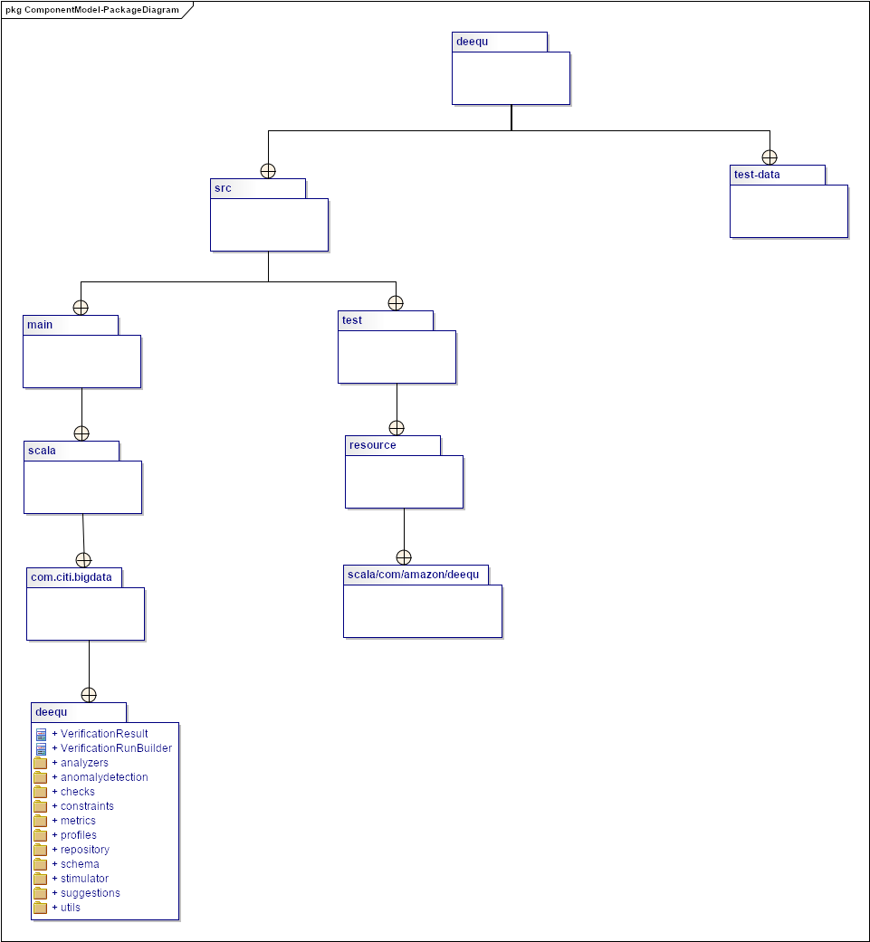
Needs and Solution Proposal (X)
Data Lake - Deequ- Component View I - Package Diagrams

Slide 22
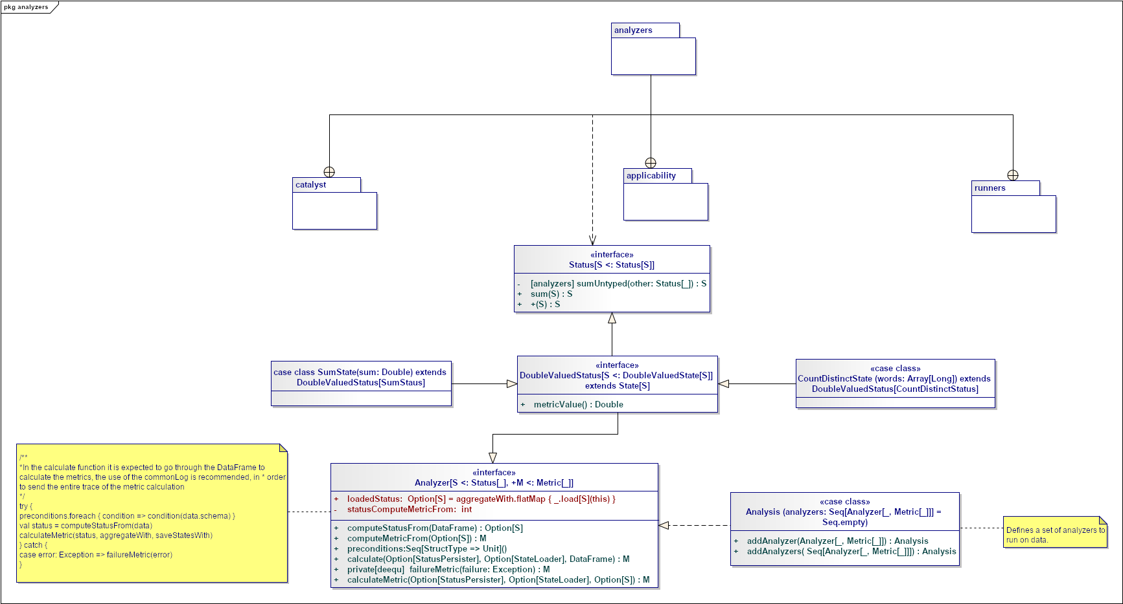
Needs and Solution Proposal (XIV)
Data Lake - Deequ- Component View IV - Analyzer Class Diagram

Slide 23
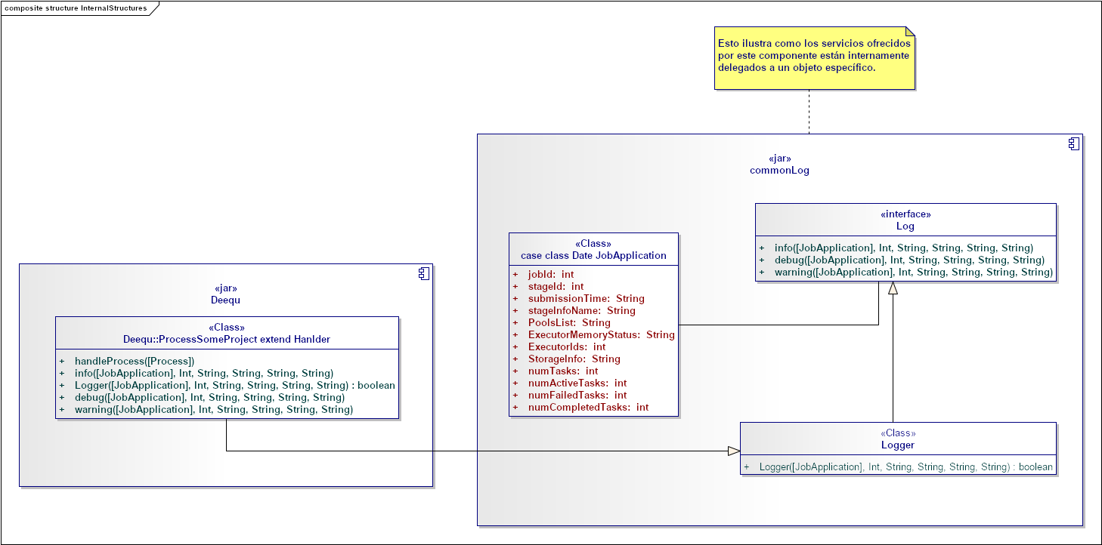
Needs and Solution Proposal (XVI)
Data Lake – Deequ - Component View V – CommonLog Internal structure
The component is designed to scale according to the needs of the projects, it allows decoupling the functionality to record the entire flow of a project. One of its main advantages is that it can be called by different clients, at different points of a certain flow.

Slide 24
Needs and Solution Proposal (XII)
Data Lake - Deequ- Component View III – Utils Class Diagram
Pending

Slide 25
Needs and Solution Proposal (XIII)
Data Lake - Deequ- Component View II – runners Class Diagram
Pending

Slide 26
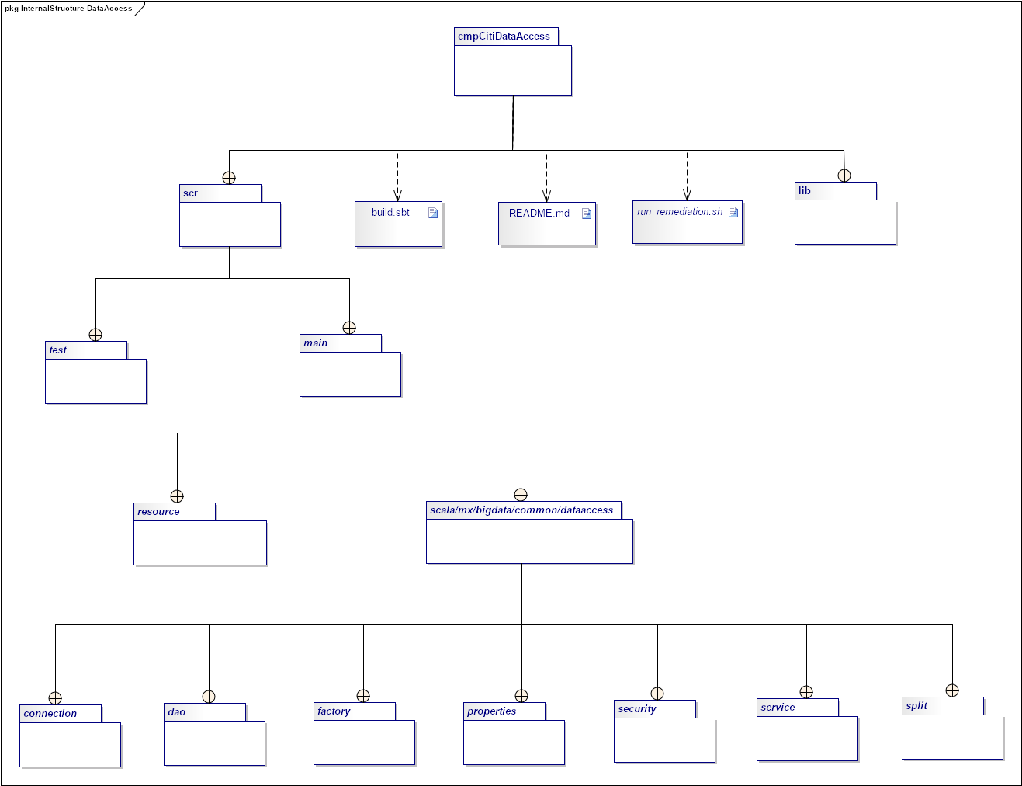
Needs and Solution Proposal (XVIII)
Data Lake - Deequ- Component View VI - cmpCitiDataAccess Internal structure
The following diagram reflects the package organization of the cmpCitiDataAccess component.

Slide 27
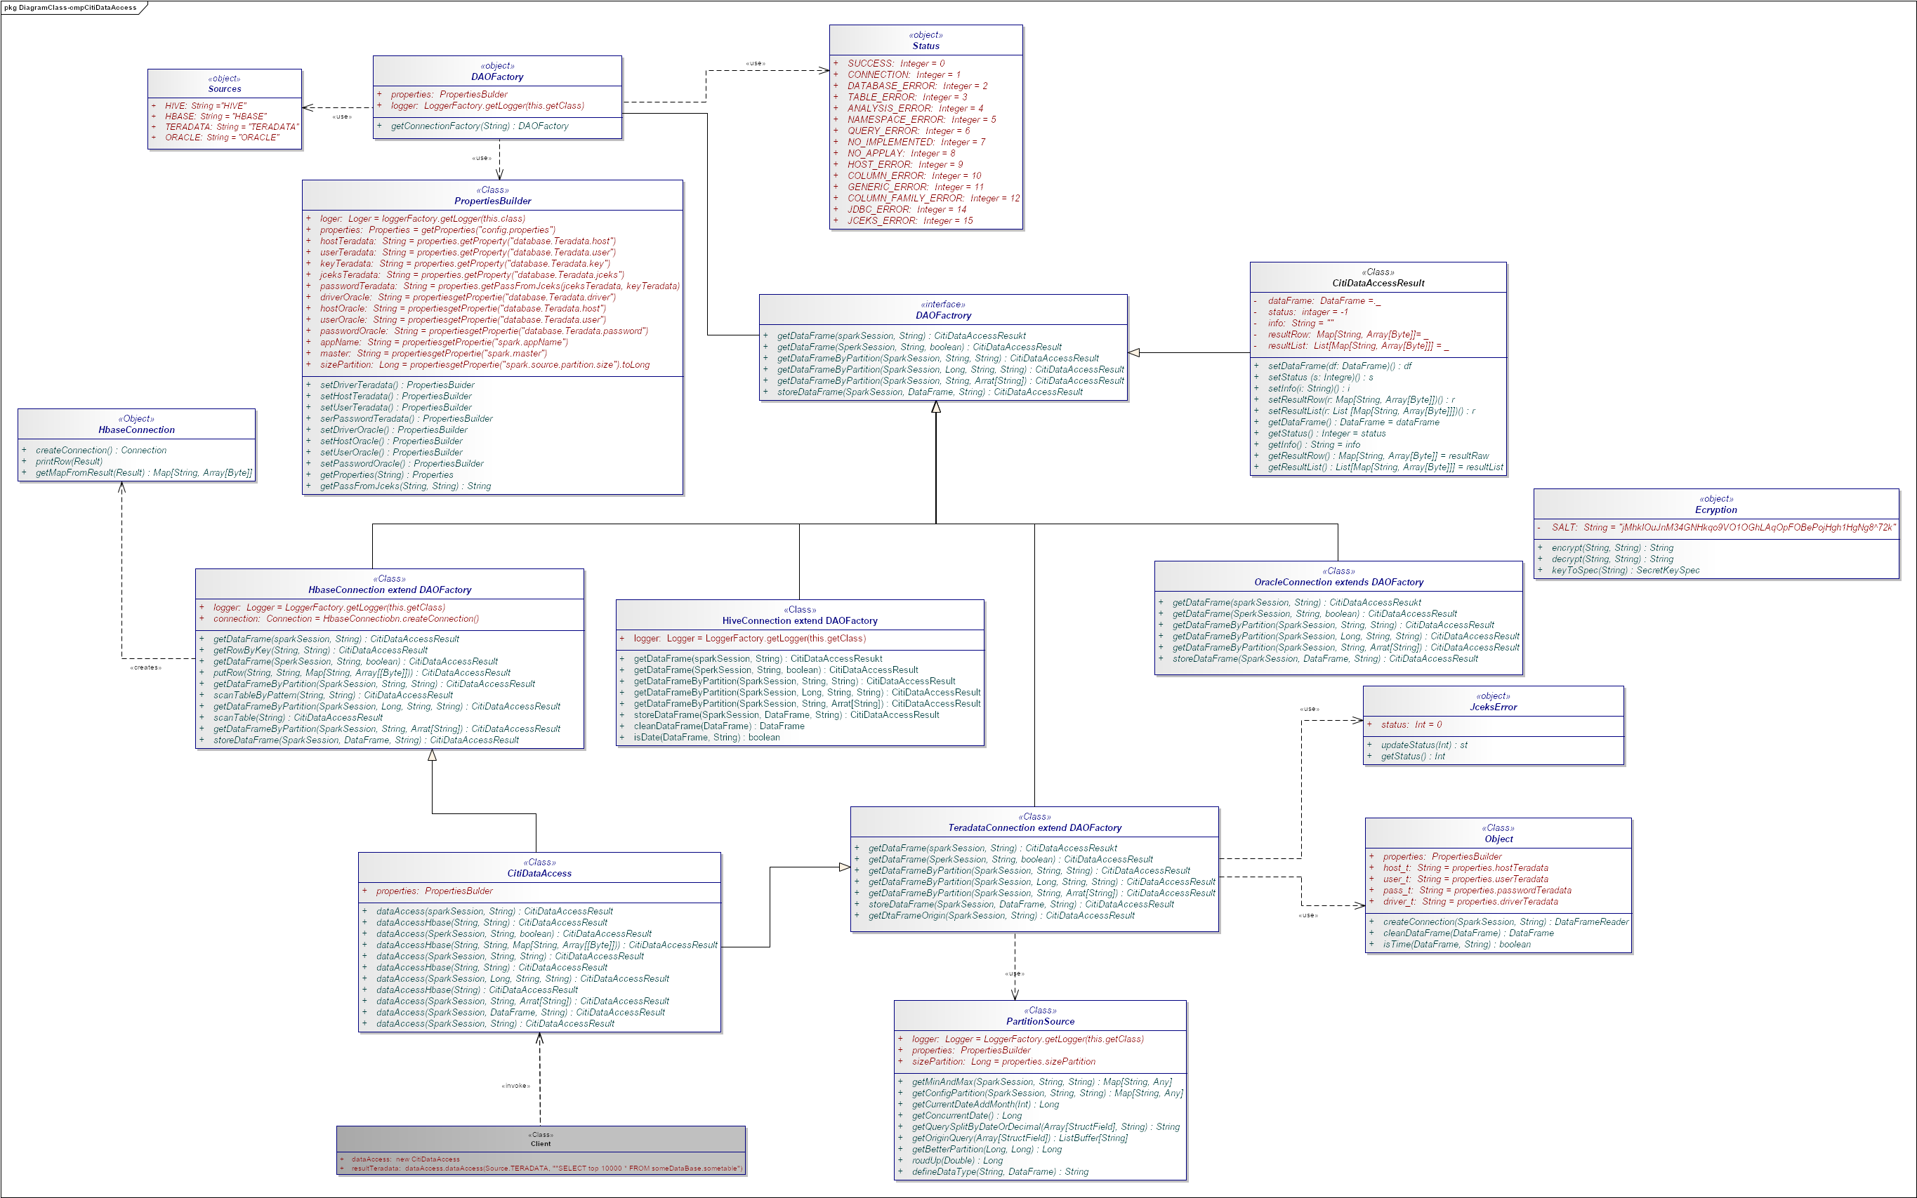
Needs and Solution Proposal (XVIII)
Data Lake - Deequ- Component View II - cmpCitiDataAccess Internal structure
The component is designed to scale according to the needs of the projects, it allows decoupling the functionality of access to different resources (Hive, Hbase, Teradata and Oracle currently). To expose this functionality for Oracle, it is only necessary to include methods in the cmpCitiDataAccess class that encapsulates the functionalities to make it the point of connection with the clients.

Slide 28
Needs and Solution Proposal (XIX)
Data Lake - Deequ – Deployment view
Pending

Slide 29
Volumetría (I)
Case of use -
Characteristic | Detalle

Slide 30
Servicios Generales (I)
Seguridad
El detalle de los lineamientos mencionados están definidos en los documentos:
Standards for the creation of topics, development and security
Confidencialidad
Communication through mutual authentication and Kerberos between Data Lake
Auditoria:
.

Slide 31
Risks and Dependencies (I)
Coexistence
The detail of the mentioned guidelines are defined
Validate the integration standards with Data Lake, with Data Governance
Risks
El detalle de los lineamientos mencionados están definidos en los documentos:
Concept tests to integrate Kerberos between Data Lake

Slide 32
Risks and Dependencies (II)
Dependencias
El detalle de los lineamientos mencionados están definidos en los documentos:
Standard of Security Controls in Data Lake

Slide 33
Standards, Patterns and Decisions of Architecture (I)
Exceptions to Standards and Architecture Patterns
Pendiene

Slide 34
Standards, Patterns and Decisions of Architecture (II)
Architecture Decisions
Decisión | Premisas | Razonamiento de la Decisión
Pendiente | Pendiente | Pendiente

Slide 35
Standards, Patterns and Decisions of Architecture (III)
Outbuildings
Dependencia | Componente externo a la solución que impacta | Fecha estimada en la que se requiere disponible
Not apply | Not apply | Not apply

Slide 36
References and Annex (I)
References
Nombre y version | Fecha | Comentarios | Rol/Departamento

